Slide 1

V450: Project Management & Implementation
Class 10
Scope of Work IV: Work Breakdown Structure
“Unless commitment is made, there are only promises and hopes; but no plans.” – Peter F. Drucker."

Slide 2
Warm-Up
My most used humble brag is …
My most hidden deficiency is …

Slide 3
Exam 1
Thursday
Classes 1-10

Slide 4
Exam 1
Taken in the classroom.
LAPTOP: Charge the battery.
Canvas/Assignments/Exam 1/Exam 1.
Begin at 12:45 p.m. Closes at 2:00 p.m.
There are 30-ish questions.
3-point multiple choice / 3-point T-F / 5-point short answer.

Slide 5
Exam 1
You may use only your hand-written notes on the exam.
If you are missing any handwritten notes and haven’t filed them before the exam, you cannot take the exam and will receive an F.

Slide 6
Exam 1
Do Not Leave the Canvas Page
Leaving Canvas – for any reason - will lead to failing the exam.
I am watching.

Slide 7
Class 12 Check-In | My Good Standing
1. Go to Canvas/Assignments.
2. Check for all missing Handwritten Notes.
3. Check for all missing Daily Check-Ins.
4. List how many of each you are missing and your plan to complete them before Exam 1.

Slide 8
ꚙ ‘The boss called …’ ꚙ
Today’s
PM Problem

Slide 9
You’re a team member working on a project when you get an email from the client requesting you to run a meeting that’s not in the scope or WBS? What do you do?
What if the request is from the PM?

Slide 10

Write down 3 possible course of actions you could take.

Slide 11

In both cases, the first order of business is to make sure the item is not already in the scope of work.
If it is a new item, then you must begin the discussion of what part of the Iron Triangle will have to change to make room for it – time, cost or quality?

Slide 12
Today’s Objectives
Know that
A WBS is built upon the broad tasks outlined in the project scope action plan.
Make sure your WBS details each and every step needed to complete the scope – in order and by whom.
Realize that a WBS is an anecdotes for confusion on who’s doing what as a project wears on.

Slide 13

Big 5 Pre-Questions/Pre-Planning
↓
Requirements
↓
Expectations
↓
Goals & Objectives
↓
Deliverables
↓
Scope of Work Action Plan
↓
Work Breakdown Structure (WBS)
The Big Plan
Notes:
Here is the flow of works when preparing the scope for a project.

Slide 14

Work Breakdown Structure

Slide 15
A project scope statement is a summary of all work that needs to be executed. It helps project managers define the boundaries of what will and what won’t be done.
A project scope action plan makes clear to the client – and the planning team – all the steps that will be performed to complete the scope.
A work breakdown structure details each and every step needed to complete the scope – in order and by whom.
Notes:
Read.

Slide 16
To move from a wish list to a project, a scope must include a work breakdown structure (WBS).
Only by studying the individual steps, people and time needed can you see the whole of what needs doing.
Invariably, you must determine this level of detail, so the sooner you create it, the better off you’ll be.
Notes:
To move from a wish list to a project, a scope must include a work breakdown structure (WBS).
Only by studying the individual steps, people and time needed can you see the whole of what needs doing.

Slide 17
A WBS is defined as the subdivision of the work into smaller, more manageable work packages.
To be effective, it must include all of the work to be done by the team.
Think in 60-minute or 1-week byte-sized chunks of work.
Notes:
You’ll break all tasks down into a time-measured unit for complete. For example, it might take 2 hours to schedule a meeting and invite all steering committee members.

Slide 18

Why is it important that everything – even mundane or obvious things like scheduling steering committee meetings or preliminary research – be included in the WBS?

Slide 19
What may seem mundane or obvious to the PM, may not be so the team member working in another location.
If even obvious tasks are left off, there’s no record indicating it should be done. The team member can rightfully ask, “How’s was I to know, you didn’t have it on the WBS?”
Notes:
Read.

Slide 20
A WBS is not shared with client because it includes proprietary information on the team’s expertise and approach.
However, it must be the absolute marching orders for the planning team, and drive everything they do. If it’s not in the WBS …?
Notes:
Read.

Slide 21
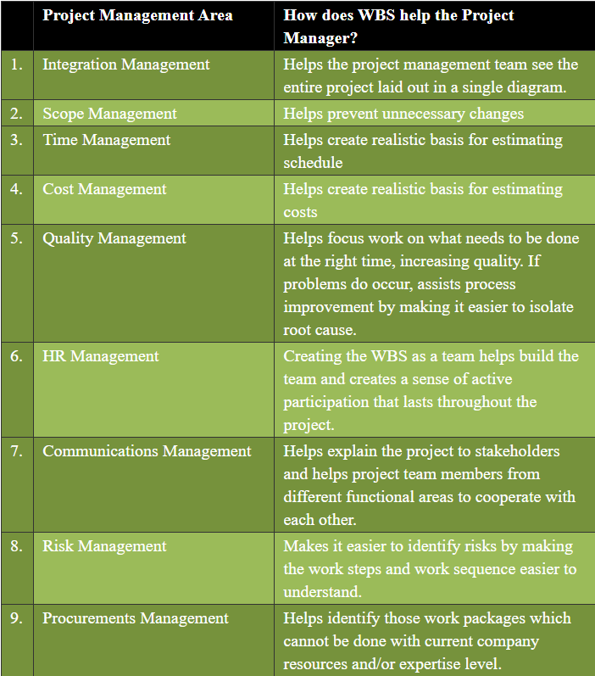
Notes:
Here are other ways the WBS is vital to the PM.

Slide 22
The secret to a good WBS is making the steps so specific that any other person (say a new team member or intern) could immediately understand what needs to be done and get started.
Too vague: “Find demographics on poverty.”
Specific: “Use U.S. Census top indicators of poverty. Compile data from American Community Survey.”
Notes:
Read.

Slide 23
A WBS can take numerous forms:
division by phases
deliverables
subprojects.
But regardless of how you structure it, the WBS should contain the people-hours, equipment, tools, contractor expenses, and any other item of cost.
Notes:
regardless of how you structure it, the WBS should contain the man-hours, equipment, tools, contractor expenses, and any other item of cost.

Slide 24
Build your WBS categories under the headings of the SOW categories or the Deliverables.

Slide 25
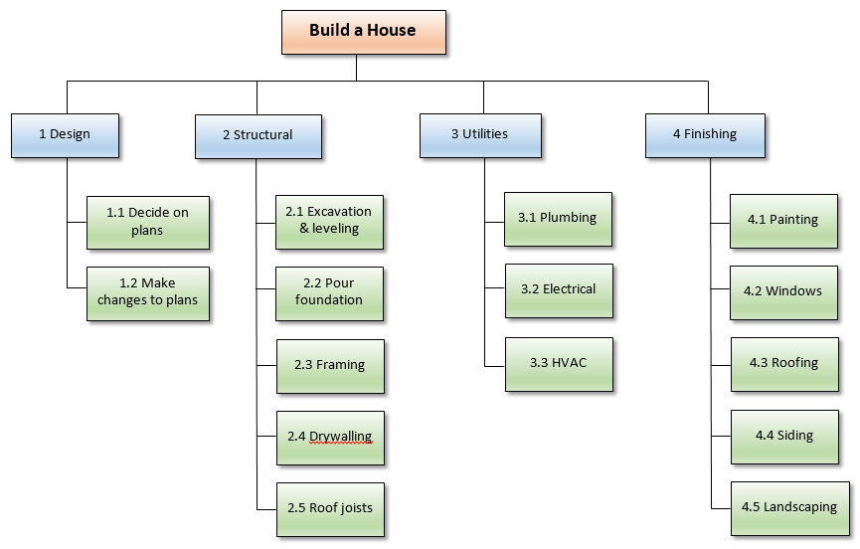
Notes:
Here’s an example of a WBS. Note the broad categories, such as Design and Structural. These can be considered Deliverables – things the client will receive. Under each of these Categories/Deliverables are all of the smaller tasks that must be competed first.

Slide 26
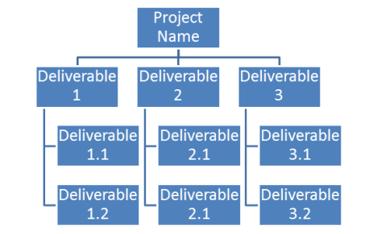
Notes:
Here’s how it might look for another type of project.

Slide 27
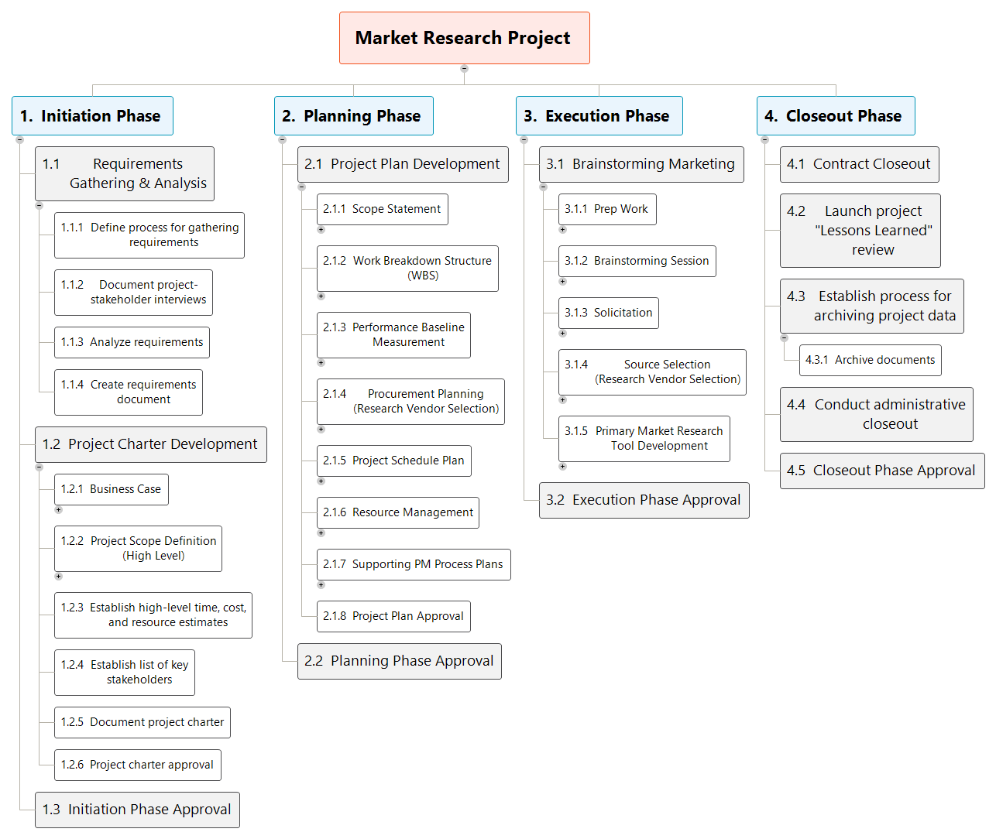
Notes:
And another example, using the PMBOK format for designing a project.

Slide 28
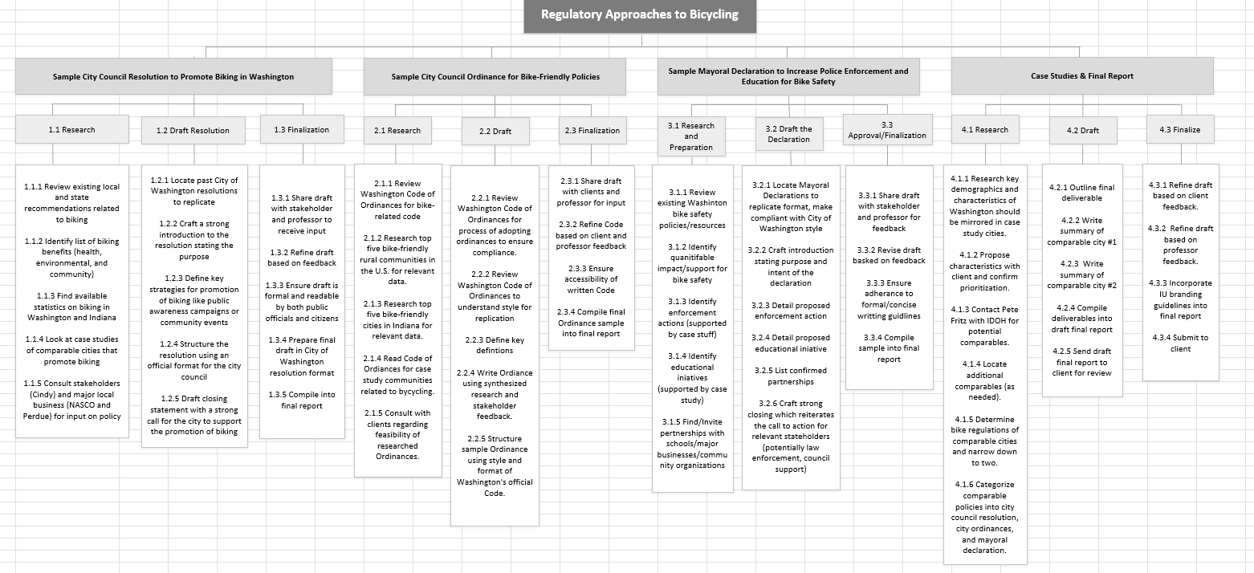
Notes:
This example is from an actual project. Note the deliverables – city council resolution – followed by the first breakdown of tasks – Research, Draft, Finalization. Follwed by all the individual bits of work.

Slide 29
Notes:
What makes this WBS so strong is the level of detail. It explains where to look for information, people to call for confirmation, etc. It is so specific that if this team working on it suddenly all disappeared, a brand new team could pick up the WBS and understand what needed to be done.

Slide 30
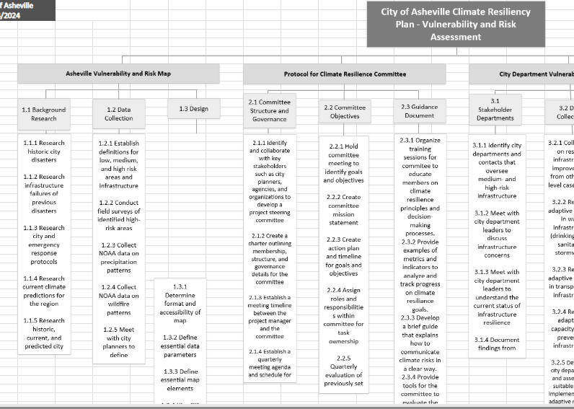
Example: WBS that includes pre-planning stage.
Notes:
I am CRAZY about this example because it actually schedules the pre-planning stage we discussed. It did not leave it to chance.

Slide 31

WBS are Anecdotes for The Free Rider

Slide 32
Alas, there are common WBS problems:
Not taking the original estimating seriously. “Too much work.”
Going into too much or not enough detail
Letting strong voices dominate
Expecting more than 100% from your WBS
Overcomplicating the structure
Adding requirements in lieu of tasks
Skipping the buy-in process
Underestimation of Soft Factors (team dynamics, abilities).
Not sticking to tasks, enforcement is not established early.

Slide 33


Include all the pre-planning tasks we’ve discussed.

Slide 34


Slide 35
Pick a project.
Individual Skills Inventory
Microsoft Teams Due Sept. 28.
My User’s Manual. Due Oct. 1.
Phase 1: Initiating Due Oct. 5.
Phase 2A Planning: Work Breakdown Structure Due Oct. 19.
Phase 2B Planning: Gannt Chart Due Nov. 2.
Phase 3: Executing. Due Nov. 9.
Phase 4: Monitoring. Due Nov. 16
Phase 5 Closing. Due Dec. 4.
Self & Peer Evaluation.

Slide 36
Expectations

Slide 37
Expectations
Project Charter

Slide 38
○ Team will review advice from book, class and slides and this analysis will reveal itself in the scenario.
● Team will apply material from book, class and slides, especially today’s lecture.
○ Team will ask Scott or Brenda about any questions, uncertainties or confusion some time well before it is due.
● What might hustle look like with this assignment? Reflect on your personal experience, show-off R&D, “looking down the track.”

Slide 39
A project charter clarifies for the clients and stakeholders why the plan is being conducted and explains its goals. This statement informs the creation of the scope of work, which in turn governs all other actions. For PMs, understanding the core components of a charter is crucial.
Study slides from classes 7-10 for vital information, then complete the charter for whichever project your pod is tackling (government, not-for-profit or environmental).

Slide 40
Rubric for Project Chater
COMPONENTS [1] project statement [2] trigger [3] action [4] scope [5] assumptions, constraints & uncertainty
PROJECT OBJECTIVES & SUCCESS CRITERIA Directly address the project's purpose. Should be SMART: Specific/Measurable/Attainable/Realistic/Time-based Criteria are tangible, quantifiable indicators.
SCOPE OF WORK High-level concepts/ What may be expected, but is not scheduled.
DELIVERABLES Logically organized and phased.
SCOPE ACTION PLAN All activities promised in the scope, listed under Deliverables.
CONSTRAINTS & UNCERTAINTIES Covers anticipated issues and possible risks.
DO YOU DELIVER? What’s the likelihood of the Project Manager giving a slight, but perceptibly positive nod at your work, (indicating they’d be claiming the work as their own)?

Slide 41
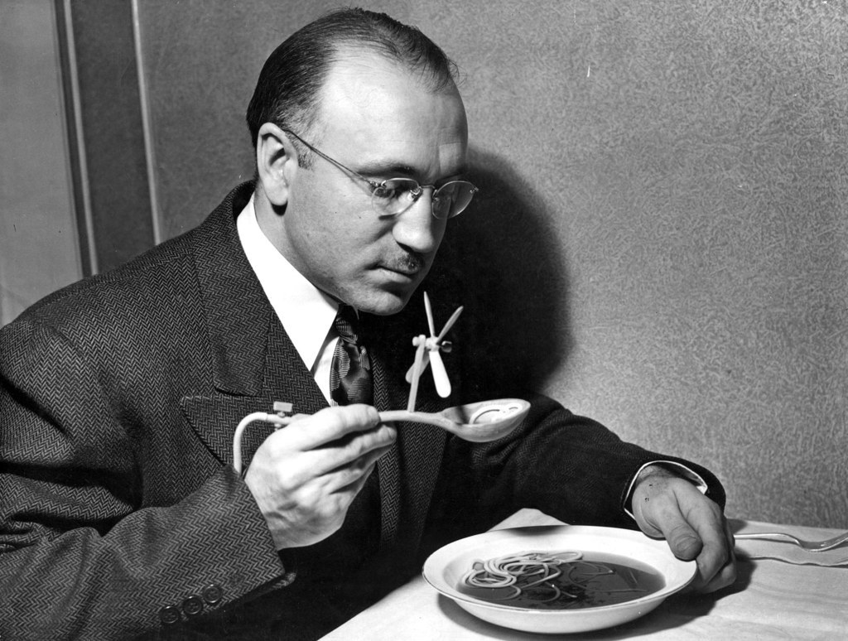

Slide 42
Class 11 Check-In

